Slide 1
MATH-352 Numerical Methods
Atifa Kanwal
atifa.kanwal@seecs.edu.pk
Office # 303, Faculty Block, SEECS, NUST

Slide 2

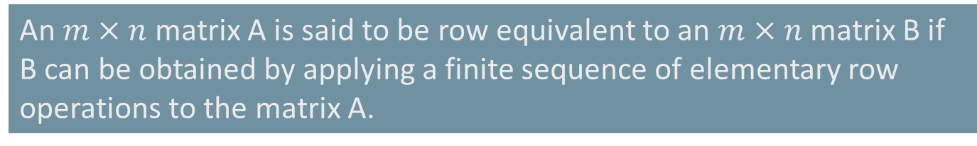
Gauss Elimination Method
Elementary Row Operation:
Interchange of two rows
Addition of a constant multiple of one row to another row
Multiplication of a row by a non-zero constant
An $m×n$ matrix A is said to be row equivalent to an $m×n$ matrix B if B can be obtained by applying a finite sequence of elementary row operations to the matrix A.

Slide 3
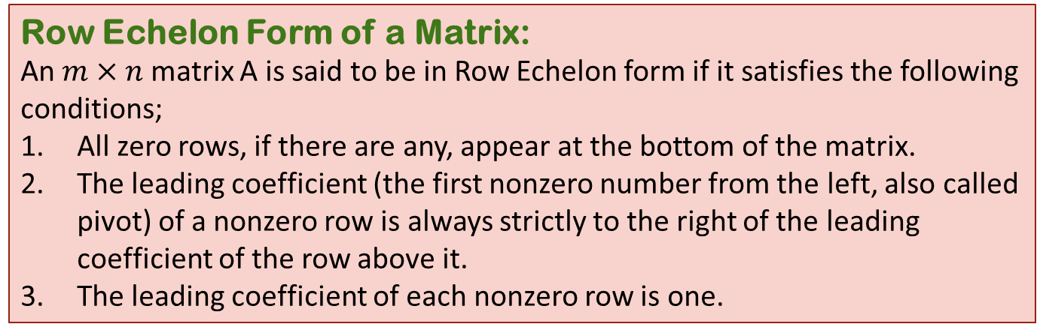
Row Echelon Form of a Matrix:
An $m×n$ matrix A is said to be in Row Echelon form if it satisfies the following conditions;
All zero rows, if there are any, appear at the bottom of the matrix.
The leading coefficient (the first nonzero number from the left, also called pivot) of a nonzero row is always strictly to the right of the leading coefficient of the row above it.
The leading coefficient of each nonzero row is one.

Slide 4
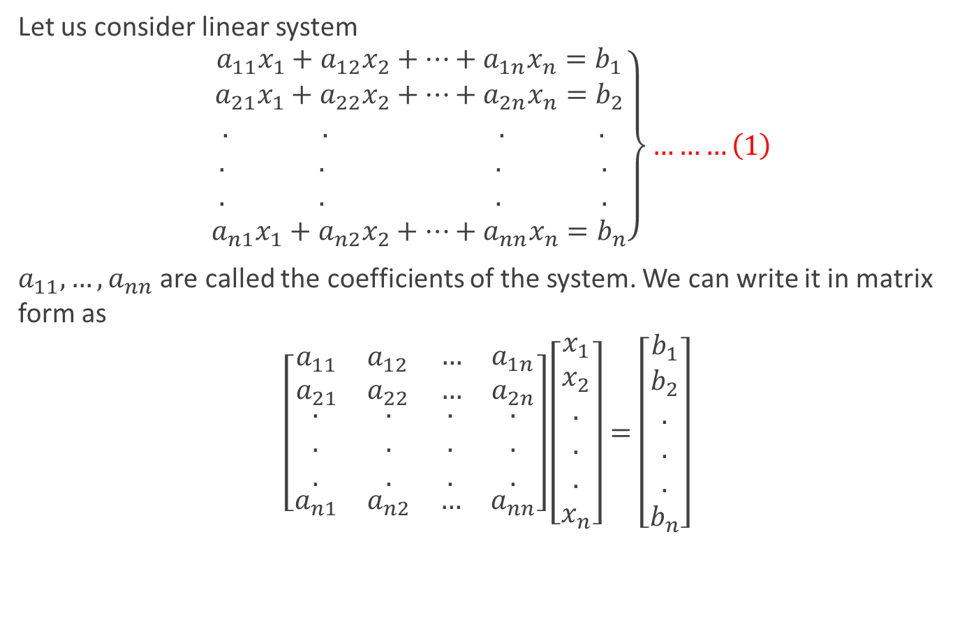
Gauss Elimination Method
Let us consider linear system
$$\left.\begin{aligned}a_{11}x_{1}+a_{12}x_{2}+…+a_{1n}x_{n}=b_{1} \\ a_{21}x_{1}+a_{22}x_{2}+…+a_{2n}x_{n}=b_{2} \\ . . . . \\ . . . . \\ . . . . \\ a_{n1}x_{1}+a_{n2}x_{2}+…+a_{nn}x_{n}=b_{n}\end{aligned}\right\}………\left(1\right)$$
$a_{11},…,a_{nn}$ are called the coefficients of the system. We can write it in matrix form as
$$\left[\begin{matrix}\begin{matrix}a_{11} & a_{12} \\ a_{21} & a_{22}\end{matrix} & \begin{matrix}… & a_{1n} \\ … & a_{2n}\end{matrix} \\ \begin{matrix}\begin{aligned}. \\ . \\ .\end{aligned} & \begin{aligned}. \\ . \\ .\end{aligned} \\ a_{n1} & a_{n2}\end{matrix} & \begin{matrix}\begin{aligned}. \\ . \\ .\end{aligned} & \begin{aligned}. \\ . \\ .\end{aligned} \\ … & a_{nn}\end{matrix}\end{matrix}\right]\left[\begin{aligned}x_{1} \\ x_{2} \\ . \\ . \\ . \\ x_{n}\end{aligned}\right]=\left[\begin{aligned}b_{1} \\ b_{2} \\ . \\ . \\ . \\ b_{n}\end{aligned}\right]$$

Slide 5
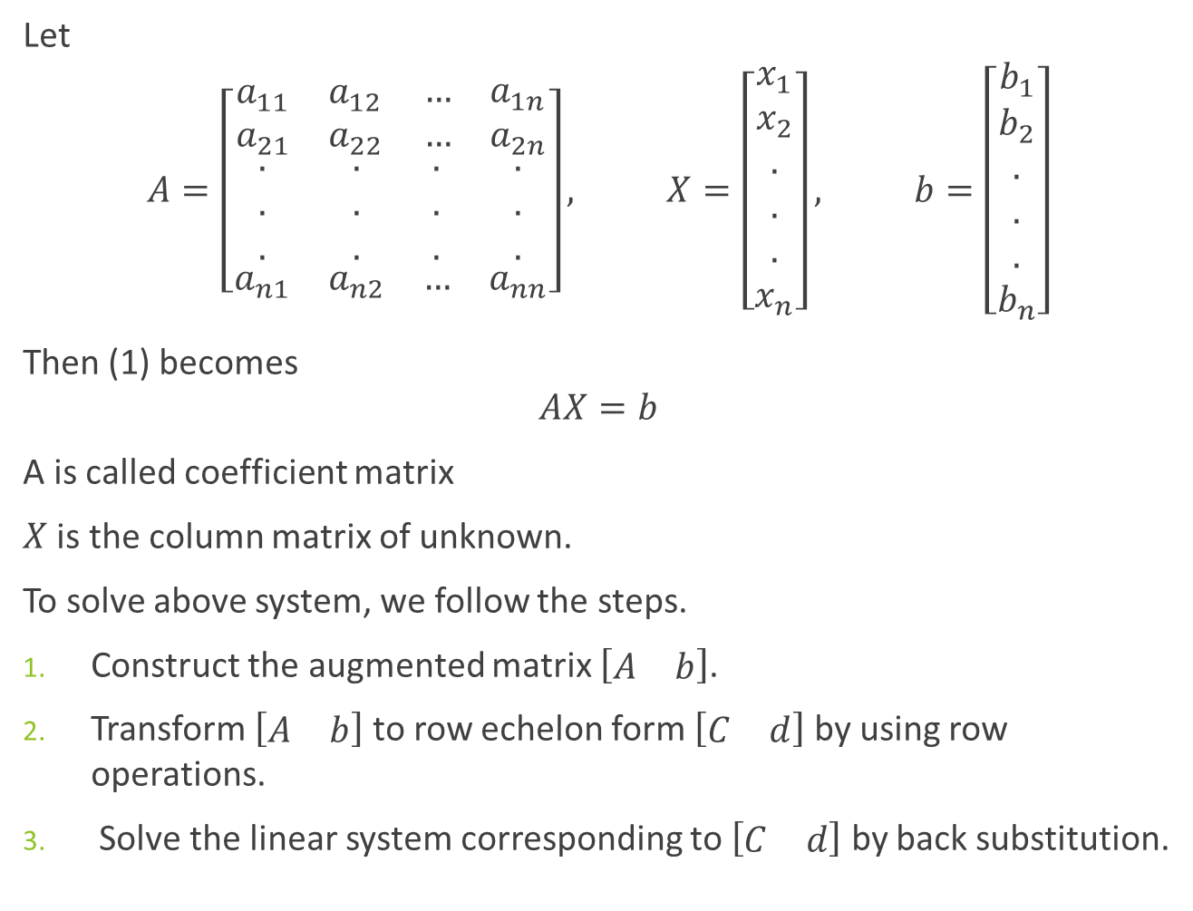
Let
$$A=\left[\begin{matrix}\begin{matrix}a_{11} & a_{12} \\ a_{21} & a_{22}\end{matrix} & \begin{matrix}… & a_{1n} \\ … & a_{2n}\end{matrix} \\ \begin{matrix}\begin{aligned}. \\ . \\ .\end{aligned} & \begin{aligned}. \\ . \\ .\end{aligned} \\ a_{n1} & a_{n2}\end{matrix} & \begin{matrix}\begin{aligned}. \\ . \\ .\end{aligned} & \begin{aligned}. \\ . \\ .\end{aligned} \\ … & a_{nn}\end{matrix}\end{matrix}\right], X=\left[\begin{aligned}x_{1} \\ x_{2} \\ . \\ . \\ . \\ x_{n}\end{aligned}\right], b=\left[\begin{aligned}b_{1} \\ b_{2} \\ . \\ . \\ . \\ b_{n}\end{aligned}\right]$$
Then (1) becomes
$$AX=b$$
A is called coefficient matrix
$X$ is the column matrix of unknown.
To solve above system, we follow the steps.
Construct the augmented matrix $\left[\begin{matrix}A & b\end{matrix}\right]$.
Transform $\left[\begin{matrix}A & b\end{matrix}\right]$ to row echelon form $\left[\begin{matrix}C & d\end{matrix}\right]$ by using row operations.
Solve the linear system corresponding to $\left[\begin{matrix}C & d\end{matrix}\right]$ by back substitution.

Slide 6
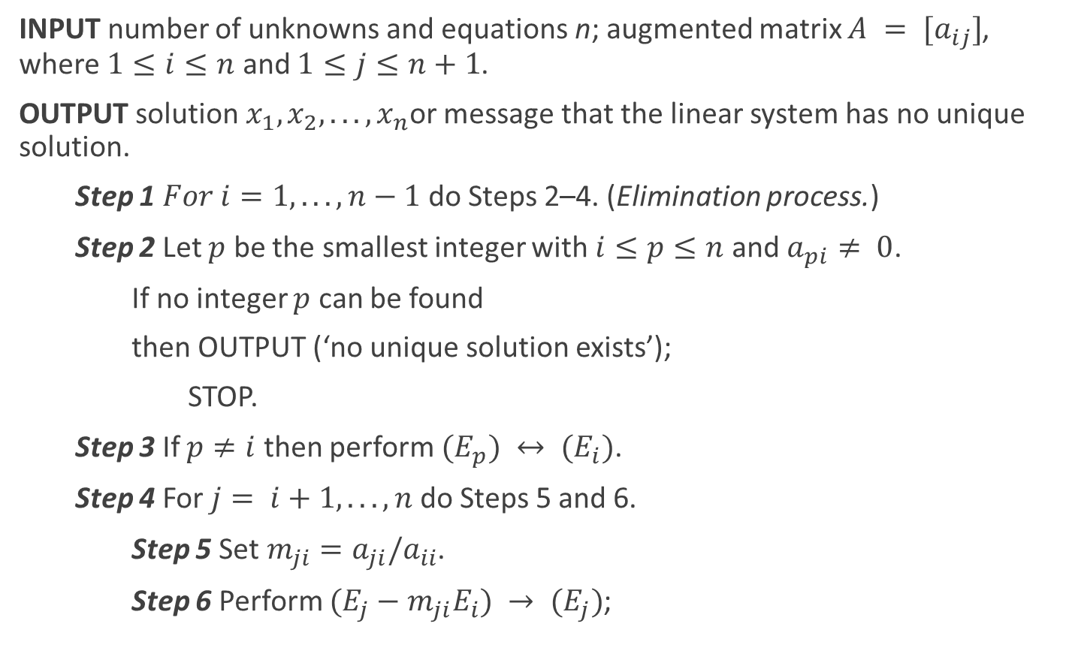
Algorithm
INPUT number of unknowns and equations n; augmented matrix $A = [a_{ij}]$, where $1≤i≤n$ and $1≤j≤n+1$.
OUTPUT solution $x_{1},x_{2}, . . . ,x_{n}$or message that the linear system has no unique solution.
Step 1 $For i=1, . . . , n−1$do Steps 2–4. (Elimination process.)
Step 2 Let $p$ be the smallest integer with $i≤p≤n$ and $a_{pi}≠ 0$.
If no integer $p$ can be found
then OUTPUT (‘no unique solution exists’);
STOP.
Step 3 If $p≠i$ then perform $(E_{p}) ↔ (E_{i})$.
Step 4 For $j= i+1, . . . , n$ do Steps 5 and 6.
Step 5 Set$m_{ji}=a_{ji}/a_{ii}$.
Step 6 Perform $(E_{j}−m_{ji}E_{i}) → (E_{j})$;

Slide 7
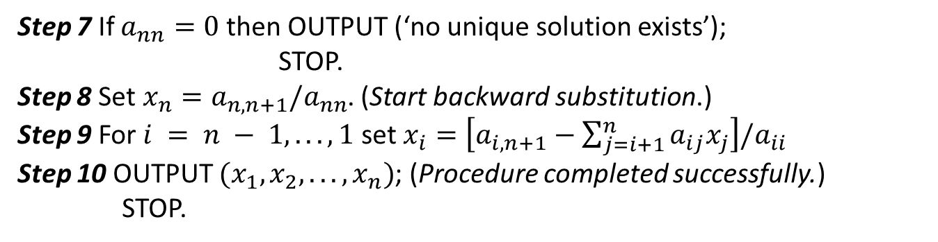
Step 7 If $a_{nn}=0$then OUTPUT (‘no unique solution exists’);
STOP.
Step 8 Set$x_{n}=a_{n,n+1}/a_{nn}$. (Start backward substitution.)
Step 9 For $i = n − 1, . . . , 1$ set $x_{i}=\left[a_{i,n+1}−\sum_{j=i+1}^{n}{a_{ij}x_{j}}\right]/a_{ii}$
Step 10 OUTPUT $(x_{1},x_{2}, . . . ,x_{n})$; (Procedure completed successfully.)
STOP.

Slide 8
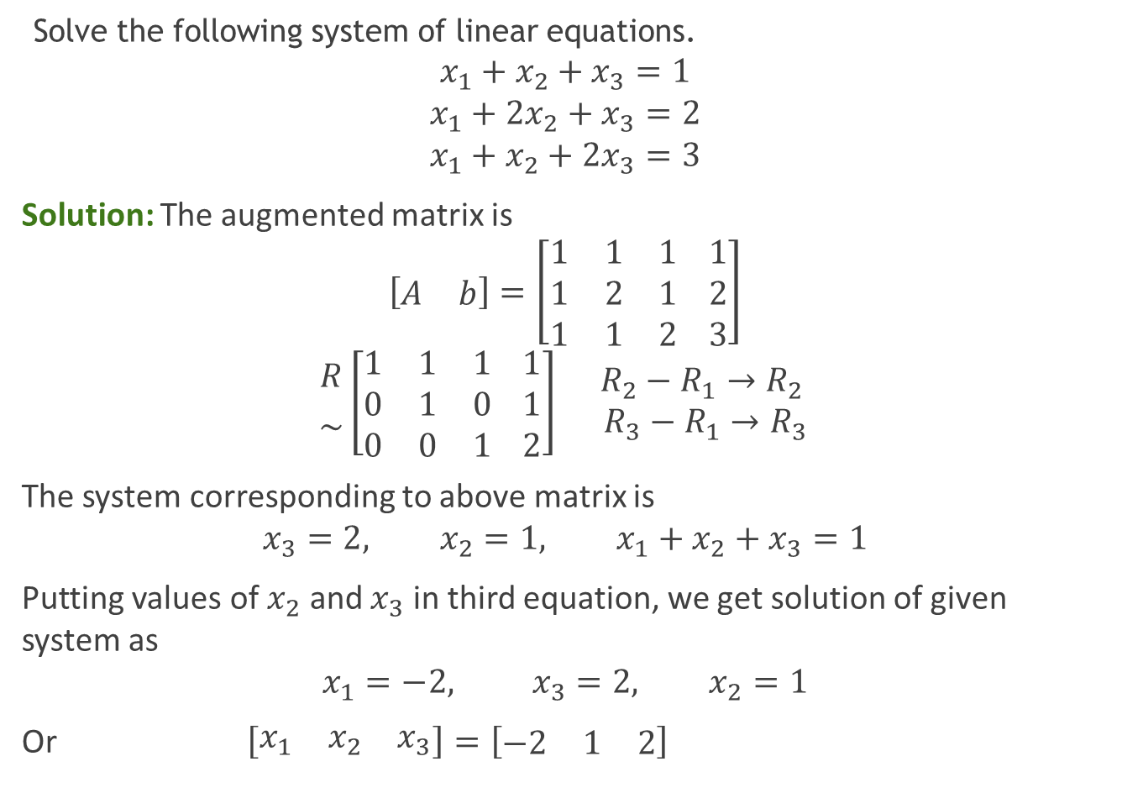
Example 1:
Solve the following system of linear equations.
$$x_{1}+x_{2}+x_{3}=1$$
$$x_{1}+2x_{2}+x_{3}=2$$
$$x_{1}+x_{2}+2x_{3}=3$$
Solution: The augmented matrix is
$$\left[\begin{matrix}A & b\end{matrix}\right]=\left[\begin{matrix}1 & 1 & 1 \\ 1 & 2 & 1 \\ 1 & 1 & 2\end{matrix} \begin{matrix}1 \\ 2 \\ 3\end{matrix}\right]$$
$${R \atop \sim }\left[\begin{matrix}1 & 1 & 1 \\ 0 & 1 & 0 \\ 0 & 0 & 1\end{matrix} \begin{matrix}1 \\ 1 \\ 2\end{matrix}\right] \begin{matrix}R_{2}−R_{1}→R_{2} \\ R_{3}−R_{1}→R_{3}\end{matrix}$$
The system corresponding to above matrix is
$$x_{3}=2, x_{2}=1, x_{1}+x_{2}+x_{3}=1$$
Putting values of $x_{2}$ and $x_{3}$ in third equation, we get solution of given system as
$$x_{1}=−2, x_{3}=2, x_{2}=1$$
Or $\left[\begin{matrix}x_{1} & x_{2} & x_{3}\end{matrix}\right]=\left[\begin{matrix}−2 & 1 & 2\end{matrix}\right]$

Slide 9
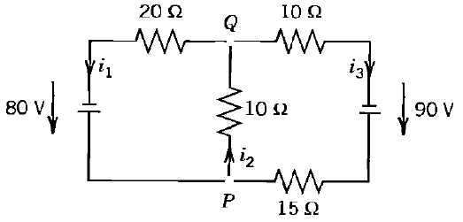
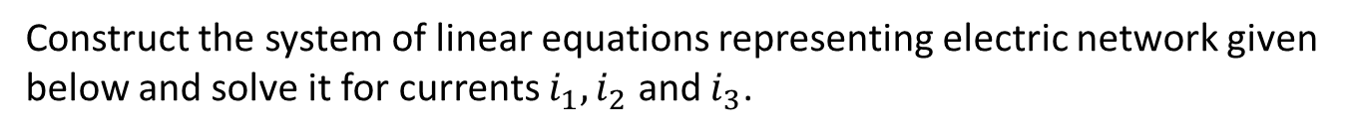
Example 2:
Construct the system of linear equations representing electric network given below and solve it for currents $i_{1},i_{2}$ and $i_{3}$.

